Slide 1
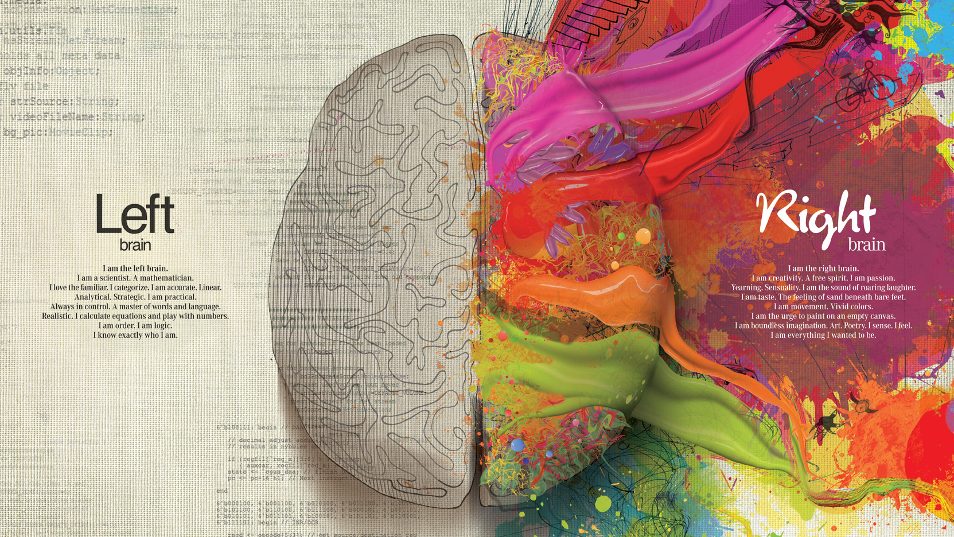

Slide 2
Steven King
Assistant Professor of Interactive Media
School of Media and Journalism
Faculty Special Appointment
Kenan-Flagler School of Business

Slide 3




In a particular order
Steven King is a
Christian
The creator God saved my life by sacrificing his son for me.
I serve at Chapel Hill Bible Church
Husband and Father
I have been married 12 years and have three boys, ages 7 and 5 and 13 days. This is my main hobby
Teacher
I want to empower students to be better than I will ever be. This is what I was called to do.
Innovator
I love to solve problems and create new ways of doing things. I am working on my third start up.

Slide 4
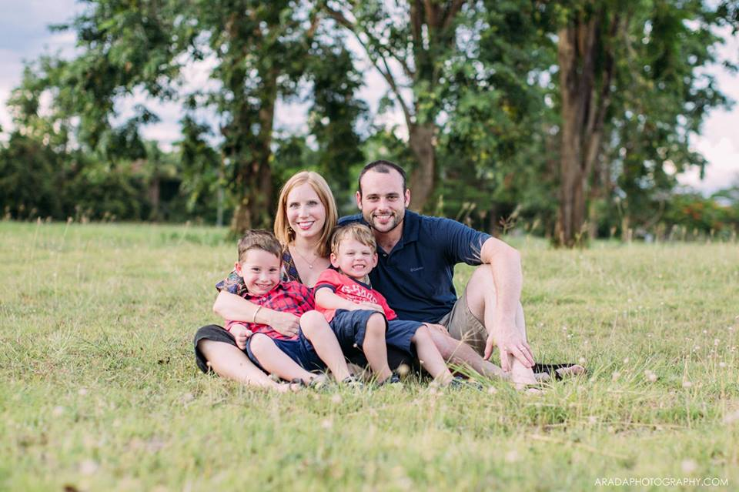
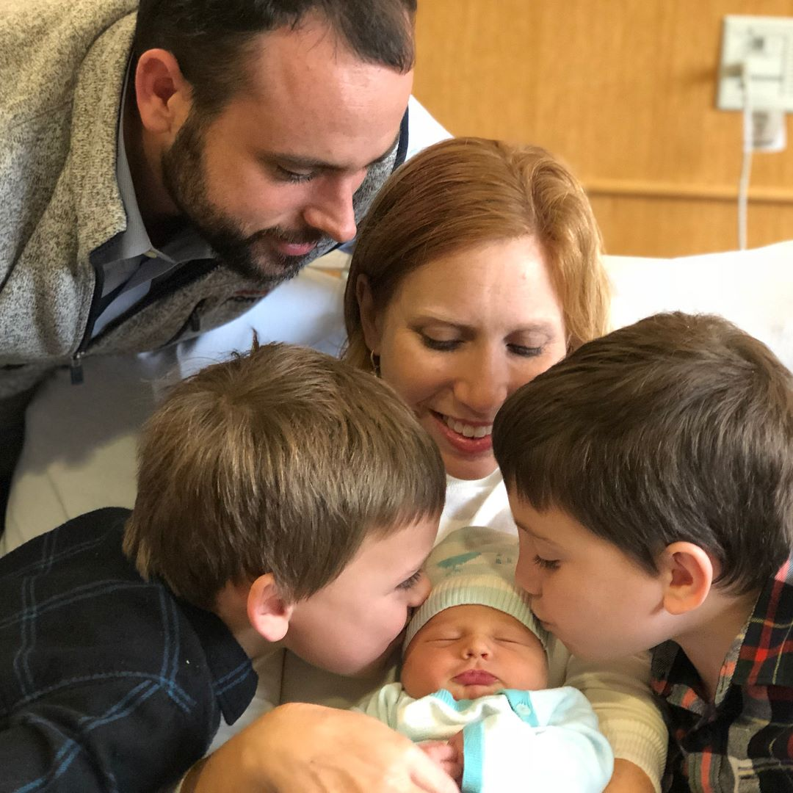
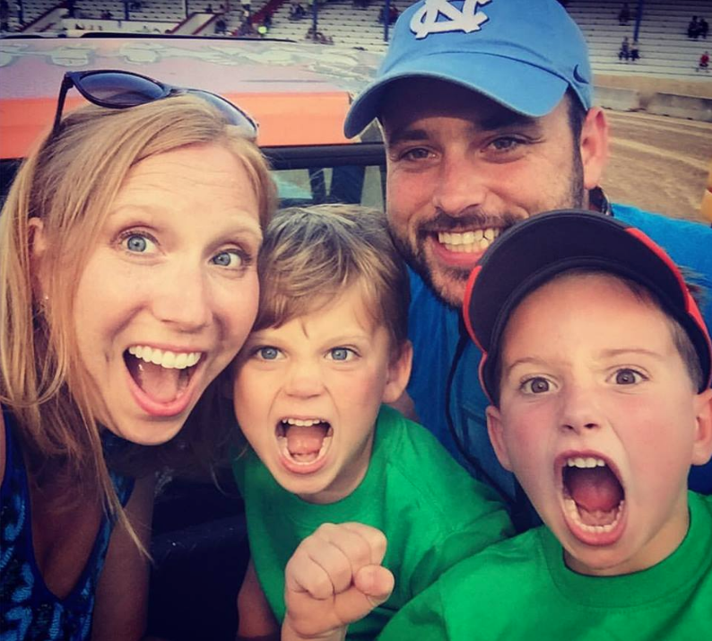
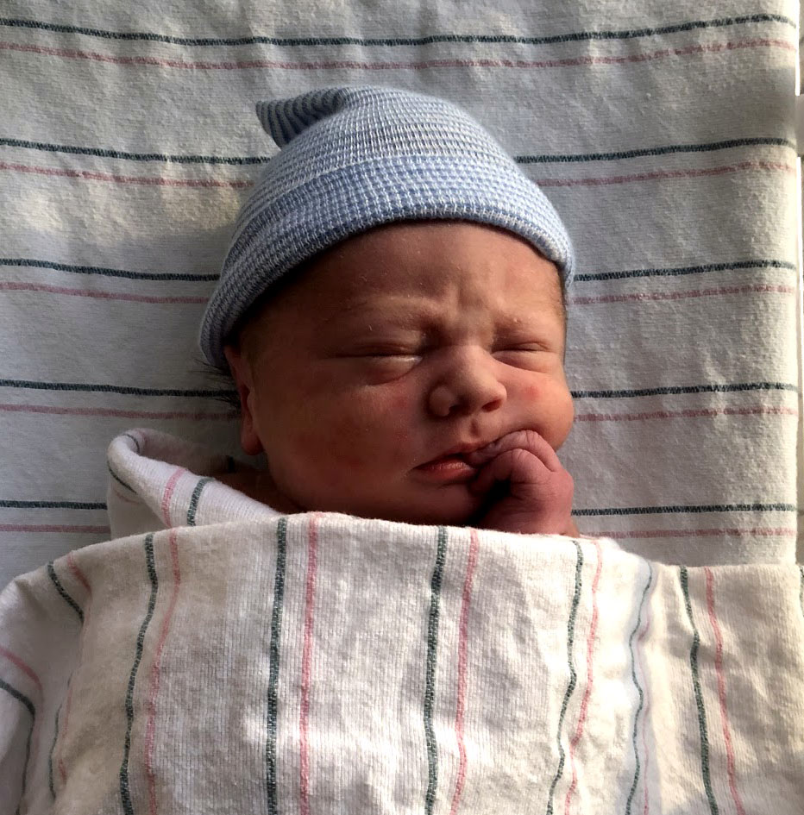
My Family
Amy
Hudson
Rusher
Canon

Slide 5
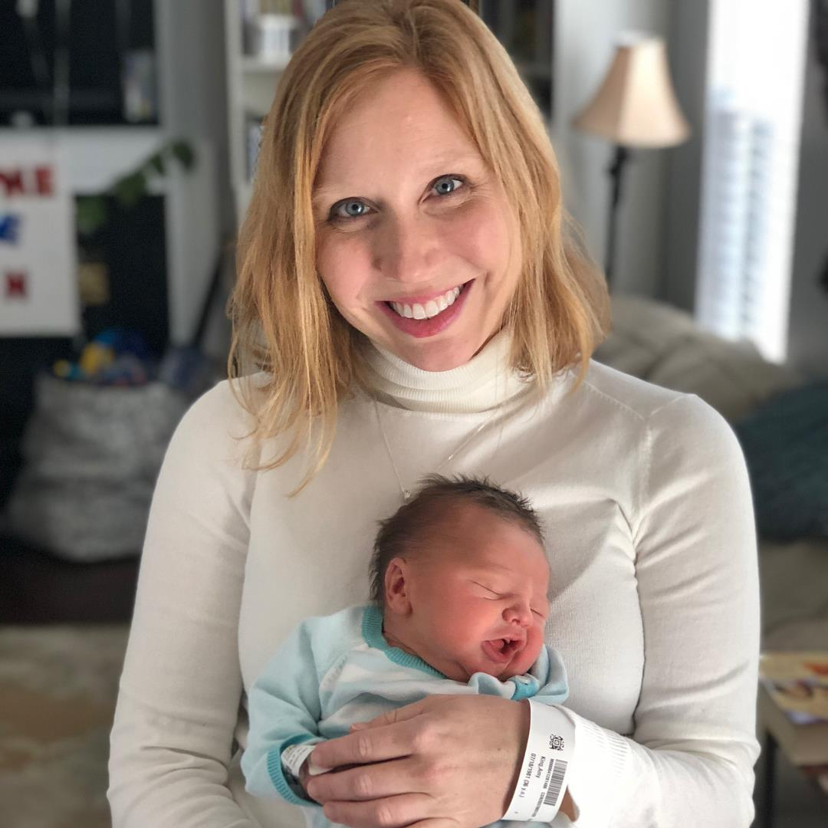
My Family
Amy
Hudson
Rusher
Canon

Slide 6
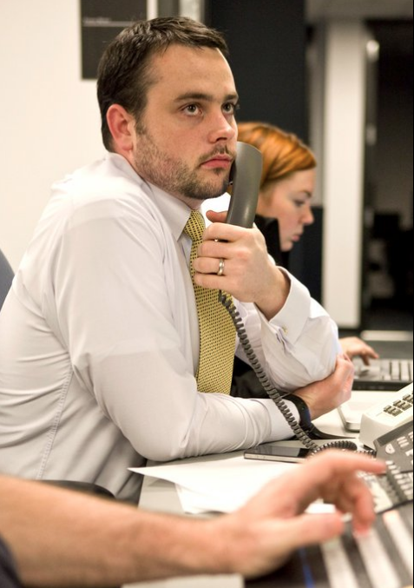
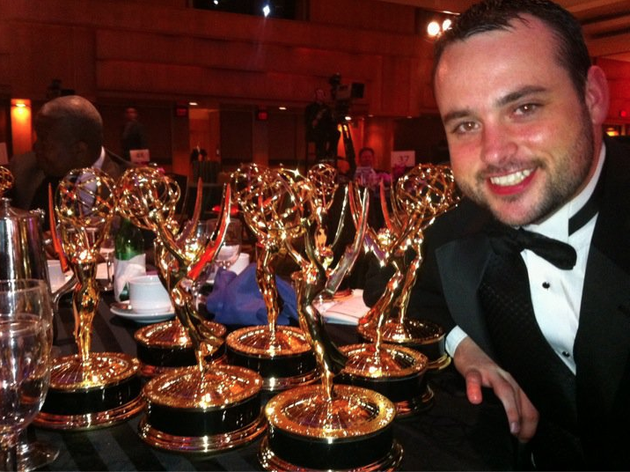
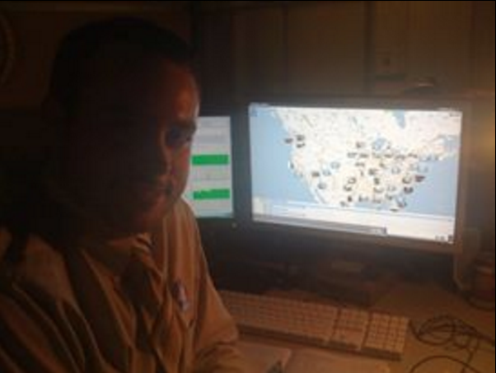
My Career
NBC Olympics
MSNBC.com
The Washington Post

Slide 7
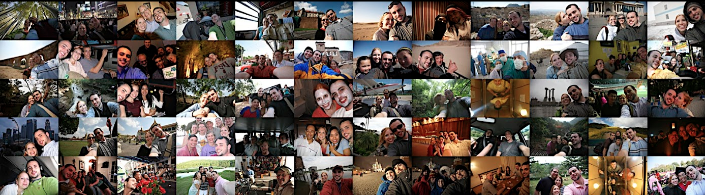
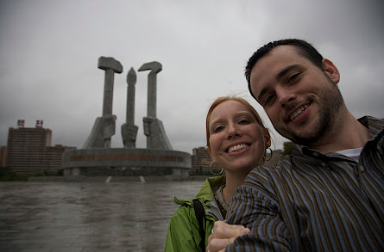
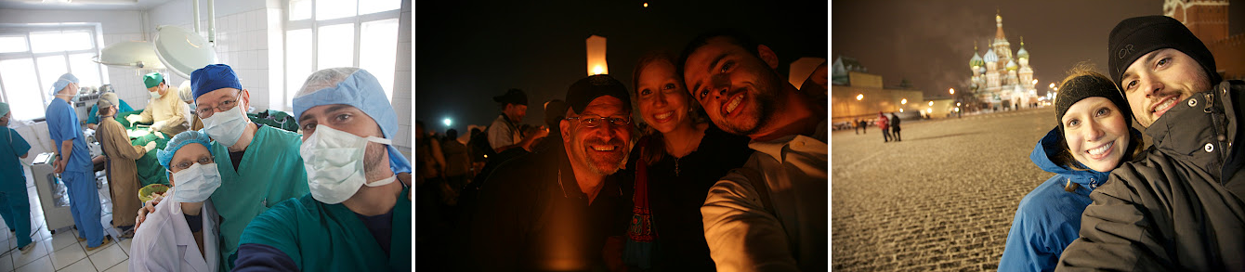

Slide 8
I hope to teach you
Learning Objectives
Learn to Learn
I can’t teach you everything, you will have to figure a lot of things out on your own
Adapt and Learn
Things change. Figure it out and lead the change.
Create Greatness
Don’t settle for average. Do everything to be great
No Excuses, No Bragging
Don’t make excuses, find solutions and let others discover how great you are.

Slide 9
How to find me
Contact
stevenTking.com
Steven_king
@steven_king
steven.king@unc.edu
Pam Evans for scheduling
pjevans@email.unc.edu
919-360-8907

Slide 10
To do today
Roll and Class Roster
Who is in this class?
Git Hub and do Syllabus
How the class works
Get Access to Labs
http://jhelp.web.unc.edu/access/
Adobe Account
http://software.sites.unc.edu/adobe/
Lynda.com
http://software.sites.unc.edu/lynda/

